Slide 1

HISTORY OF THE EMERGENCE OF INDEPENDENT BANGLADESH
Dr. Md. Abdul Alim
B. A (Hon’s), M. A (History), M. Phil (Raj), Ph. D (Raj)
Email:doctorabdulalim64@gmail.com
Cell: +880 01718-787466

Slide 2
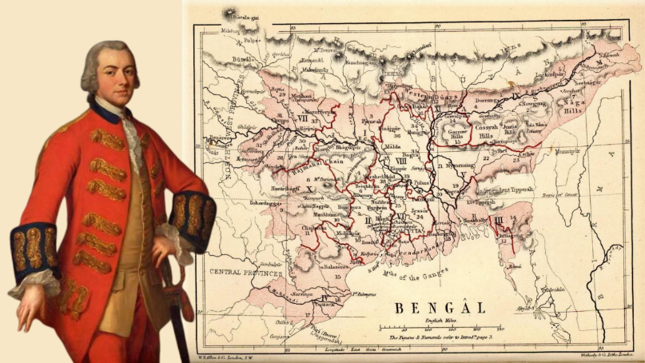
PERMANENT SETTLEMENT
During his tenure as Governor-General in 1793, Lord Cornwallis instituted the concept of permanent settlement. The British East India Company and the landlords of Bengal signed an agreement there that fixed the land revenue, and it was also known as the permanent settlement of Bengal. It is well known that the corporation relied heavily on land revenue to levy taxes on the Indian population.

Slide 3

PERMANENT SETTLEMENT BACKGROUND
Before the British advent in Bengal, there was a class of Zamindars in Bengal, Bihar, and Odisha who collected revenue from land on behalf of the Mughal Emperor or his representative, the Diwan.
After the Battle of Buxar in 1764, the East India Company was granted the Diwani of Bengal. But then the Company found itself unable to collect revenue from the innumerable number of farmers in rural areas. They also did not have a good understanding of local laws and customs.

Slide 4
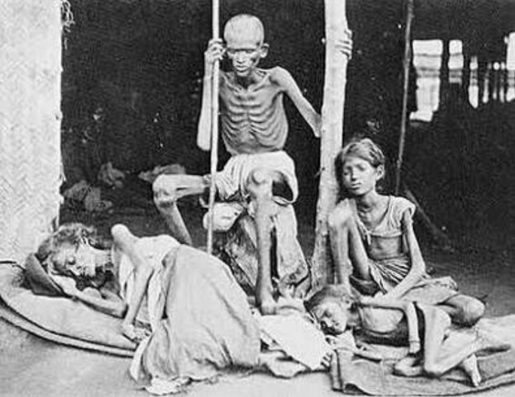
PERMANENT SETTLEMENT BACKGROUND
The severe Bengal famine of 1770 occurred partly due to this neglect by the Company.
Then, Warren Hastings tried to bring in some reforms like the five-yearly inspections. Here, the revenue collection was awarded through an auction to the person promising the highest revenue. Due to the dangerous implications and effects of such a system, Hastings also experimented with the annual settlement of land. But this too did not improve conditions.
Then, Lord Cornwallis under directions from the then British PM, William Pitt, proposed the Permanent Settlement system in 1786. This came into effect in 1793, by the Permanent Settlement Act of 1793.

Slide 5

PURPOSES OF THE PERMANENT SETTLEMENT ACT
If the permanent settlement is implemented, the zamindars will invest in the land. The zamindar will use his surplus money for the development of the land for his benefit. So, agricultural production will increase and the country's economy will be prosperous.
There will be an agricultural revolution in Bangladesh under the leadership of zamindars, like England.
The Zamindar society will remain loyal to the British government. The British government would establish a political base in India through the Zamindar class as the social ruler.

Slide 6
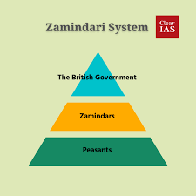
FEATURES OF THE PERMANENT SETTLEMENT
Landlords or Zamindars were recognized as the owners of the land. They were given hereditary rights of succession of the lands under them.
The Zamindars could sell or transfer the land as they wished.
The Zamindars’ proprietorship would stay as long as he paid the fixed revenue at the said date to the government. If they failed to pay, their rights would cease to exist and the land would be auctioned off.

Slide 7
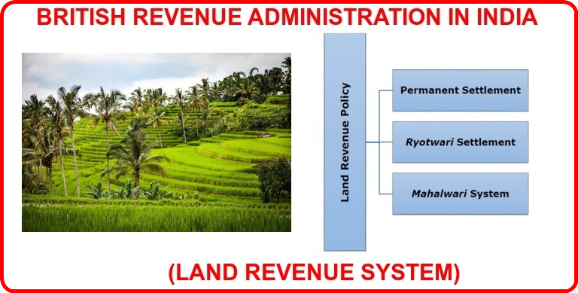
FEATURES OF THE PERMANENT SETTLEMENT
The amount to be paid by the landlords was fixed. It was agreed that this would not increase in the future (permanent).
The fixed amount was 10/11th portion of the revenue for the government and 1/10th was for the Zamindar. This tax rate was way higher than the prevailing rates in England.
The Zamindar also had to give the tenant a patta which described the area of the land given to him and the rent he had to pay the landlord.

Slide 8
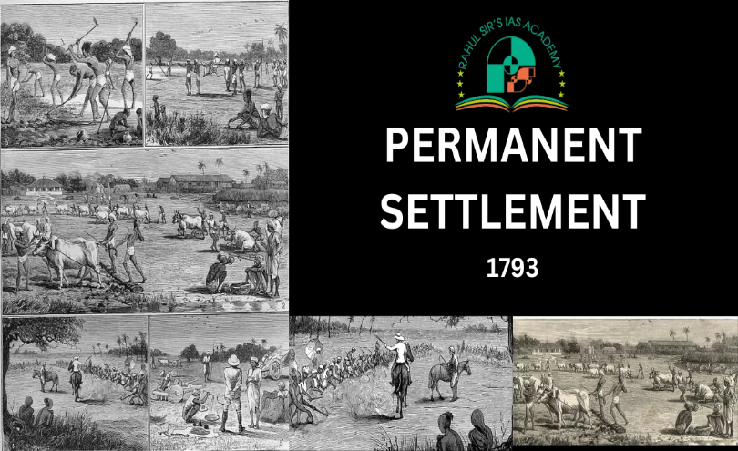
PERMANENT SETTLEMENT IMPACTS ON PEASANTS
For the peasants, the system of permanent settlement was extremely domineering. This is because they made up a crucial element of the system but received neither adequate care nor attention for their lands.
Regarding the distribution of revenue payments to the peasants, the landowners were not at all forgiving. When sales were very strong, they occasionally had to borrow money from moneylenders, who then exploited it to further their agendas. In the worst situation, if they don’t pay the revenue, they risk being evicted from their land.

Slide 9
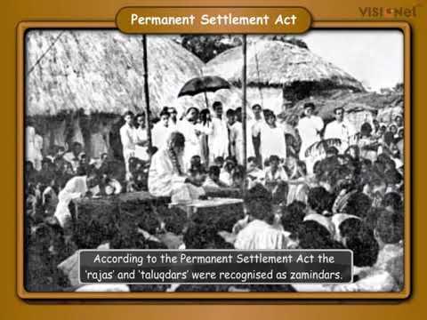
PERMANENT SETTLEMENT IMPACTS ON ZAMINDAR
The introduction of the permanent settlement system affected zamindars as well since, despite receiving a fixed income from the British, they profited from the increased production from the land, which ultimately benefited both the British and the zamindars. For zamindars, the permanent settlement system’s huge fixed revenues made settlements challenging.
The British seized their properties after they stopped paying their debts. Zamindars frequently sublet their properties and relocate to urban areas. Thus, the middleman served as a link between the zamindars and the farmers. The zamindar was the go-between for various things in addition to acting as a broker for British politics.

Slide 10

PERMANENT SETTLEMENT IMPACTS ON COMPANY
The permanent settlement system of 1793 guaranteed the business had a steady stream of cash. One of the primary objectives of the Permanent Settlement Act was to increase production in agriculture. The zamindars had no desire to enhance the land, even though they did nothing about it. During the first decade of the 19th century, both prices and cultivation increased. This led to a larger income for zamindars due to the predetermined revenue level, but no profit for the business.

Slide 11

MERITS OF THE PERMANENT SETTLEMENT
The responsibility of taking care of farmers fell upon the shoulders of the Indian landlords. Being sons of the soil, they could reach the far corners of the region and also understand local customs very well.
Because of the permanent nature of the system, there was a sense of security for everyone. The company knew the amount it would get in revenue. The landlord also was assured of the amount. Finally, the farmers also, instead of the patta were certain of their holdings and knew how much rent was to be paid.
Since the settlement was permanent, the Zamindars would have an interest in the improvement in the land thereby improving the revenue.

Slide 12

DEMERITS OF THE PERMANENT SETTLEMENT
The basic demerit of this system was that the efficiency depended upon the nature of the Zamindars. If they were good, the interests of the farmers and the land were looked after very well. They would make improvements in the land which would be beneficial to everyone concerned. But if the landlords were bad, they were negligent of the plight of the farmers and the conditions of the land.
This created a class of hereditary landlords forming the upper aristocracy in society who generally led luxurious and extravagant lifestyles.
The Zamindars were generally favorable to the British administration and supported the British even during the freedom struggle. There were exceptions.

Slide 13

DEMERITS OF THE PERMANENT SETTLEMENT
The land assessment was not done properly and land revenue was fixed arbitrarily. This meant that both productive and unproductive land was expected to furnish revenue at the same rates. This created a burden on the farmers of unproductive land. Also, in the case of productive land, it was a loss of revenue to the government.
The revenue rates were so high that many Zamindars became defaulters. In time, this system proved to have disastrous effects. In 1811, the British government warned against the imposition of permanent settlements without a proper land survey.

Slide 14

CORNWALLIS CODE
Cornwallis brought the ad-hoc character of administration practiced by the previous regimes to an end. He made some experiments in the revenue and local administrations. But soon he came to a firm conclusion about the colonial state and its administration. By turning the Nawab into a pensioner, Cornwallis abolished the Nizamat institution and assumed to himself all residue powers of the Nawab. He established detailed rules of governance and rules of business of the state. The whole body of the system that he established goes by the name of Cornwallis Code.

Slide 15

CORNWALLIS CODE
The entire Cornwallis Code may be conceived within the limits of 48 Regulations proclaimed by Cornwallis in May 1793. The Regulations described the structure of respective institutions and their rules of business. The main administrative institutions under the Cornwallis system may be summarized under the following heads.

Slide 16
ADMINISTRATION- COLONIAL PERIOD UNDER EAST INDIA COMPANY
Revenue administration since 1793 The kernel of the administrative system of the colonial state was revenue collection. Most of the laws and rules that Cornwallis framed had direct or indirect bearing on the revenue administration. Basic features of Lord Cornwalis’s land settlement of 1793 can be sited as under:
The Zamindars were made the owners of the land.
The company’s share in revenue was fixed with the Zamindars.
The Zamindars could sell & purchase lands.
The state had no direct contact with the peasants

Slide 17
ADMINISTRATION & REFORMATION- UNDER EAST INDIA COMPANY
Civil Service
Until the arrival of Cornwallis, civilians were traders at the same time. For their services to the government, officers were paid very minimally. They were hence allowed to indulge in making money by private trade and other means. Furthermore, in addition to their normal salary, district collectors were allowed commissions on the collections of revenue. Cornwallis brought these ruins anomalies to an end. He separated trade from the administration. The Board of Revenue was entrusted with administrative affairs and the Board of Trade with commercial affairs. The officers in the administration were never to be transferred to the trading division of the company for the officers in the trading division, to administration. He created two cadres of administrative services - covenanted and uncovenanted. The covenanted officers were to be nominated by the Court of Directors, and the uncovenanted, by the Fort William Government. Natives were excluded from civil service, thereby making the civil administration an all-white affair.

Slide 18
ADMINISTRATION & REFORMATION- UNDER EAST INDIA COMPANY
Police Administration
Cornwallis abolished the police powers of the Nizamat. Under the Police Regulation of 7 December 1792, the Zamindars in the rural areas and the Kotwals in the urban areas were deprived of their traditional privileges of policing. Instead, English magistrates were given control of the police. The district judge was made. Additionally, the district magistrate was given control of the police. Every district was divided into a police zone covering an area of 400 square miles, and each such area was to be guarded by a Police Superintendent assisted by an establishment of constables. The district judge, in the capacity of the district magistrate, would appoint the police superintendent, and the latter would appoint constables.

Slide 19
ADMINISTRATION & REFORMATION- UNDER EAST INDIA COMPANY
Judicial Administration
Cornwallis separated the judiciary from the executive and established the rule of law by making all, rulers and ruled, equal in the eyes of the law. For civil justice, district courts were instituted, which dealt with both civil and revenue matters. Above them were four provincial courts at Calcutta, Murshidabad, Dhaka and Patna. At the top was the Sadr Diwani Adalat for civil justice and Sadr Nizamat Adalat for criminal justice. The Governor General and his council members made these Sadr Adalats. Native advisers were engaged to help them in matters relating to Muslim and Hindu laws.

Slide 20
ADMINISTRATION & REFORMATION- UNDER EAST INDIA COMPANY
Administrative reforms to 1857
Cornwallis laid the foundation of the British colonial administration. But his system soon turned out to be inconsistent with the colonial state. The India-wide Empire which was never in the mind of Cornwallis when he formulated the principles of his administrative system. Within a decade of his departure from India, the Bengal State of the company assumed sub-continental proportions. The very fact of the expansion, dilution and diffusion of the state compelled the central government to modify the original code of Cornwallis.
The foundation of the Cornwallis system was the Permanent Settlement. Its original constitution was materially modified by the Regulation (1799), which had armed the Zamindars with summary powers over their tenantry, including coercion and eviction. The Zamindars also got the right to sublet their land for any length of time, which was originally limited to a maximum period of ten years (Regulation 5, 1812 and Regulation VIII of 1819). Zamindars also got the right to create perpetual intermediate tenures.

Slide 21
ADMINISTRATION & REFORMATION- UNDER EAST INDIA COMPANY
Bentinck’s Reformation
Under the system of 1793, natives were excluded from responsible positions. From the early nineteenth century, this rule was relaxed under the pressure of work at the local level. During William Bentinck’s administration, a higher-ranking judicial post called Principal Sadr Amin with the powers and jurisdictions of an additional judge was created. Bentinck's administration had also created a post of Deputy Collectors. Furthermore, the magisterial duties were separated from the district judge and transferred to the district collector. The district collector was called the District Magistrate and Collector. This reform had made significant compromise with the principle of separation of the judiciary from the executive.

Slide 22
ADMINISTRATION & REFORMATION- UNDER EAST INDIA COMPANY
In 1829, the administrative unit of the Division were consisting of several adjoining districts headed by a Divisional Commissioner. Besides revenue affairs and district administration, the Divisional Commissioner was also entrusted with police powers. This administrative arrangement remained intact more or less down to the end of the raj.

Slide 23
ADMINISTRATION UNDER BRITISH CROWN (1858–1947)
The India Rebellion of 1857 replaced rule by the Company with the direct control of Bengal by the British Crown. Fort William continued to be the capital of British-held territories in India. The Governor of Bengal was concurrently the Governor General of India for many years.
In 1877, when Victoria took the title of "Empress of India", the British declared Calcutta the capital of the British Raj. The colonial capital developed in Calcutta's municipality, which served as the capital of India for decades. A center of rice cultivation and the world's main source of jute fibre; Bengal was one of India's largest industrial centers.
From the 1850s, the industry was centered around the capital Calcutta. The railway was created in Britain in 1825. It was introduced in the United States in 1833, Germany in 1835, Italy in 1839, France in 1844 and Spain in 1848. The British government introduced the railway to Bengal in 1854. Several rail companies were established in Bengal during the 19th century, including the Eastern Bengal Railway and Assam Bengal Railway. The largest seaport in British Bengal was the Port of Kolkata, one of the busiest ports in the erstwhile British Empire.

Slide 24
ADMINISTRATION UNDER BRITISH CROWN (1858–1947)
The Kolkata Stock Exchange was established in 1908. Other ports in Bengal included the Port of Narayanganj, the Port of Chittagong and the Port of Dhaka. Bengali ports were often free trade ports which welcomed ships from across the world. There was extensive shipping with British Burma.
Two universities were established in Bengal during British rule, including the University of Calcutta and the University of Dacca. Numerous colleges and schools were established in each district. Most of the Bengali population nevertheless remained dependent on agriculture, and despite Bengali social and political leaders playing a major role in Indian political and intellectual activity, the province included some very undeveloped districts.

Slide 25
ADMINISTRATION UNDER BRITISH CROWN (1858–1947)
At its greatest extent, the Bengal Presidency covered north and northeast India, as well as Burma, Singapore and Penang. The Bengal Presidency had the highest gross domestic product in British India. Bengal hosted the most advanced cultural centers in British India. A cosmopolitan, eclectic cultural atmosphere took shape. There were many anglophiles, including the Naib Nazim of Dhaka. A Portuguese missionary published the first book on Bengali Grammar. A Hindu scholar produced a Bengali translation of the Quran. However, Bengalis were also divided by religion due to the political situation in the rest of India.

Slide 26
ADMINISTRATION & REFORMATION UNDER BRITISH CROWN (1858–1947)
Administration under the crown
The abolition of the East India Company and the assumption of the Indian administration directly by the British Crown led to a series of administrative reforms. Though many of the institutions evolved by the company administration had continued, but their application and operational modality were not the same.
Civil service
The forms of civil service developed during the last decade of the company rule had continued almost unchanged under the crown. The Indians filled in the posts of deputy magistrate and collectors and sub-deputy magistrates and collectors mostly. The Act XVI of 1868 abolished the designations of the native judicial officers - Principal Sadr Amin and Sadr Amin, and the new designations of "Subordinate Judge" were adopted. From 1922, examinations for the Indian Civil Services began to be held simultaneously in India and England. Consequently, the greater number of educated Indians got opportunities to compete and get entries into the superior services. Furthermore, Bengal Provincial Civil Services were created with powers and functions close to those of the ICS. By 1935, more than half of the ICS jobs were held by Indians, while the Bengal Civil Services became alternative avenues to absorb the western educated gentlemen.

Slide 27
ADMINISTRATION & REFORMATION UNDER BRITISH CROWN (1858–1947)
Police administration
The police system was reviewed by the Police Commission of 1860, and the Police Act V of 1861 was enacted with the objective of colonial governance. A separate police department was created under an Inspector General of Police, who was responsible for the efficiency and discipline of the entire police department. The Inspector General of Police was assisted by a Deputy Inspector General. The District Superintendent of Police was controlled by the divisional commissioner.
A jail code was prepared to administer jails. The police and jail systems evolved under the Police Act V of 1861. Even today, the Bangladesh police administration is governed largely by the Police Act V of 1861.
The colonial government had formally abandoned the village chowkidari system of the Mughal regime. All Zamindars and talukdars were required then to maintain Choukidars or village police called. The system was discontinued after the permanent settlement. But informally many zamindars continued to maintain chowkidars on their estates. The system was revived in 1870 under the Chowkidari Act of 1870.

Slide 28
ADMINISTRATION & REFORMATION UNDER BRITISH CROWN (1858–1947)
Local Government
The local government system of the native rulers was discontinued under the Cornwallis Code of 1793, which made the district collector the main agent of local administration. All local government institutions at village and pargana levels were abolished. The Zamindars were shorn of their responsibilities as regards maintaining law and order.
The European district collector appeared as the sole authority of a district. From the last decade of the company rule, the concept of local municipal government was first conceived. Under the Act of XXVI of 1850, the concept of establishing the Municipal Government for major towns was first adopted. The district magistrate was made the chairman of the municipality. The chairman was to be assisted by nominated commissioners, of whom less than seven commissioners were to be selected from amongst the native elite. The proceeds of ferries, bazaar tolls and road levies would make the sources of revenue for the municipalities. The municipal government was extended to smaller towns under the District Town Act or Municipal Act VI (BC) of 1868.
In rural areas, a kind of local government was established by the Bengal Village Chaukidari Act of 1870, which divided the countryside into 'Unions' comprising about ten or twelve square miles. These areas were placed under panchayats or committees selected by the magistrates. These panchayats had the power of appointing chowkidars and collecting chaukidaricess from the village people to maintain the system.

Slide 29
ADMINISTRATION & REFORMATION UNDER BRITISH CROWN (1858–1947)
Constitutional reforms towards independence
The Great Sepoy Revolt of 1857 led to the end of the company rule and the beginning of constitutional reforms of administration and, finally, independence of British rule.
The Indian Council Act of 1861 laid the foundation for the representative government in India. In 1862, a legislative council was established in Bengal, though its legislative powers remained extremely limited. The growing public pressure for granting representative self-government persuaded parliament to enact 1892 an Indian Councils Act, which increased the strength of the legislative councils of the governor-general and of provincial governors.

Slide 30
ADMINISTRATION & REFORMATION UNDER BRITISH CROWN (1858–1947)
The system of the elected council was begun under the Morley-Minto reforms Act, 1909. The system got wider representation under the India Acts of 1919. The universal franchise qualified by property tax was granted under the India Act of 1935. The Act of 1919 transferred some powers to elected representatives who formed a government to run the affairs of the transferred subjects. Full representative government was established under the Act of 1935, under which responsible government was established in every province of British India, including Bengal. The fullest and absolute transfer of power to the elected representatives took place under the India Independence Act of 1947.

Slide 31


